Slide 1
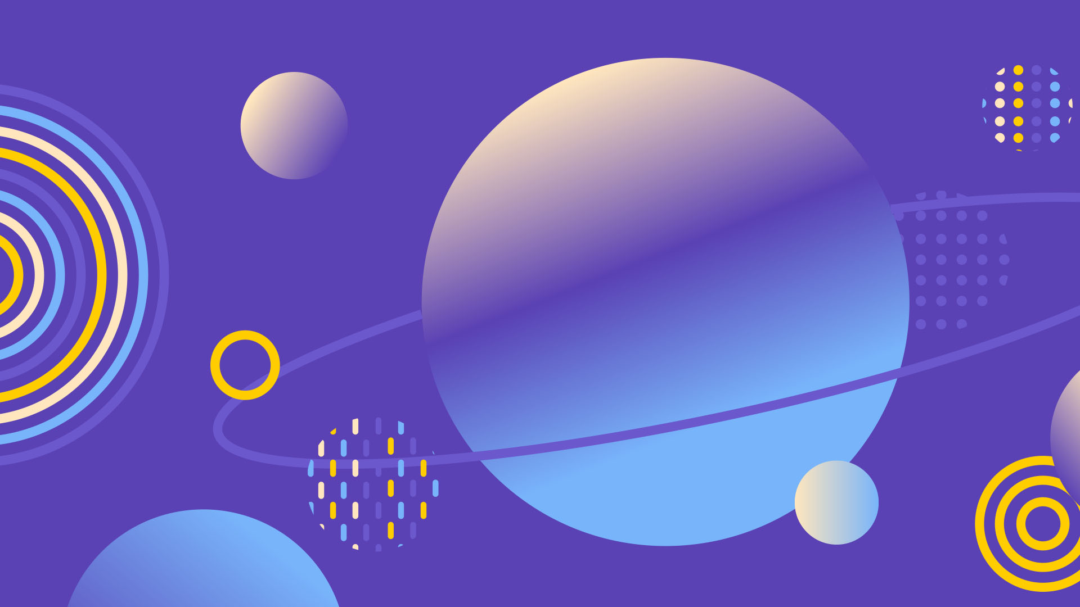








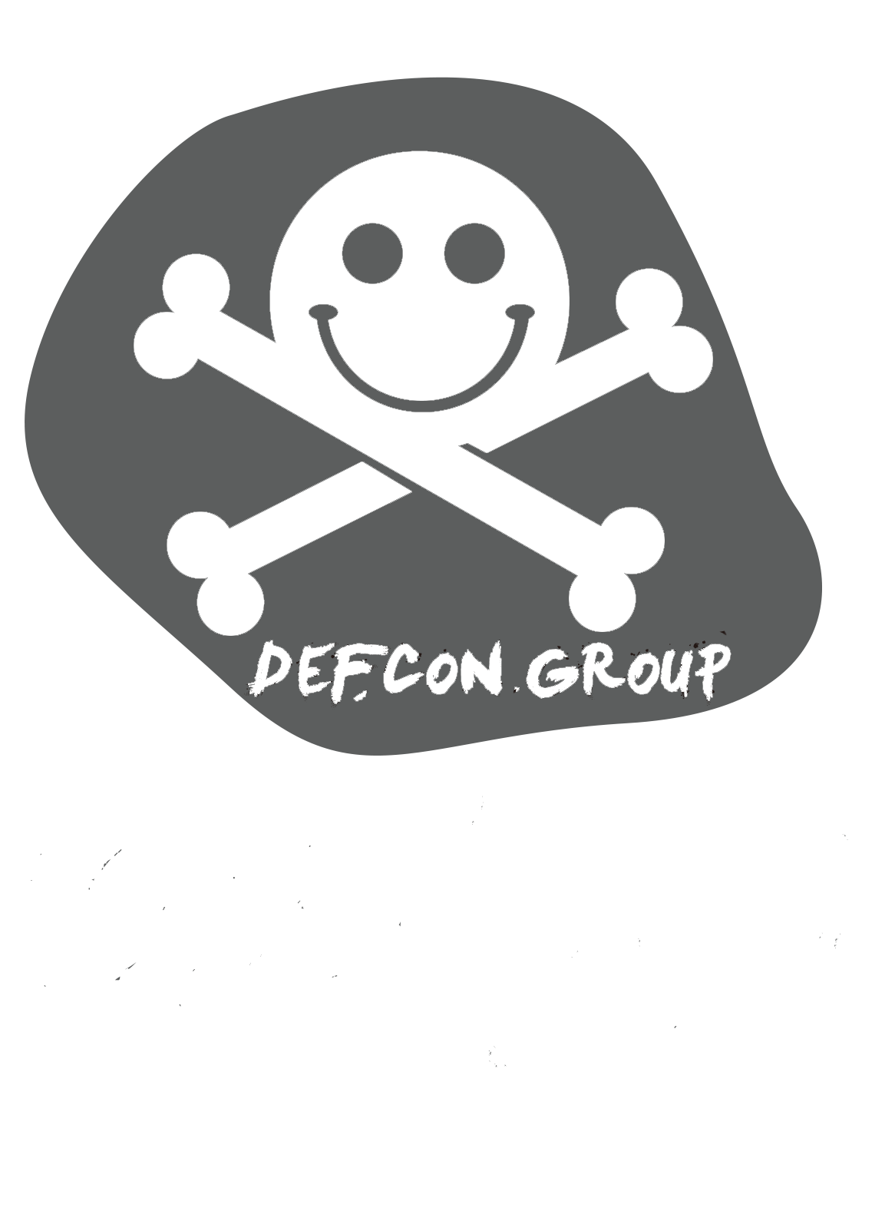


Slide 2
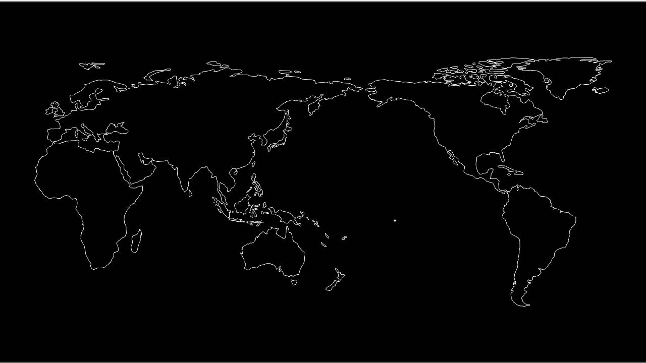



DEFCON GROUPS 中国
Basic Survival Guide Against Hackers
Through destruction comes new norm
Through grouping comes amplified power
不破不立，不聚不利
Notes:
2

Slide 3
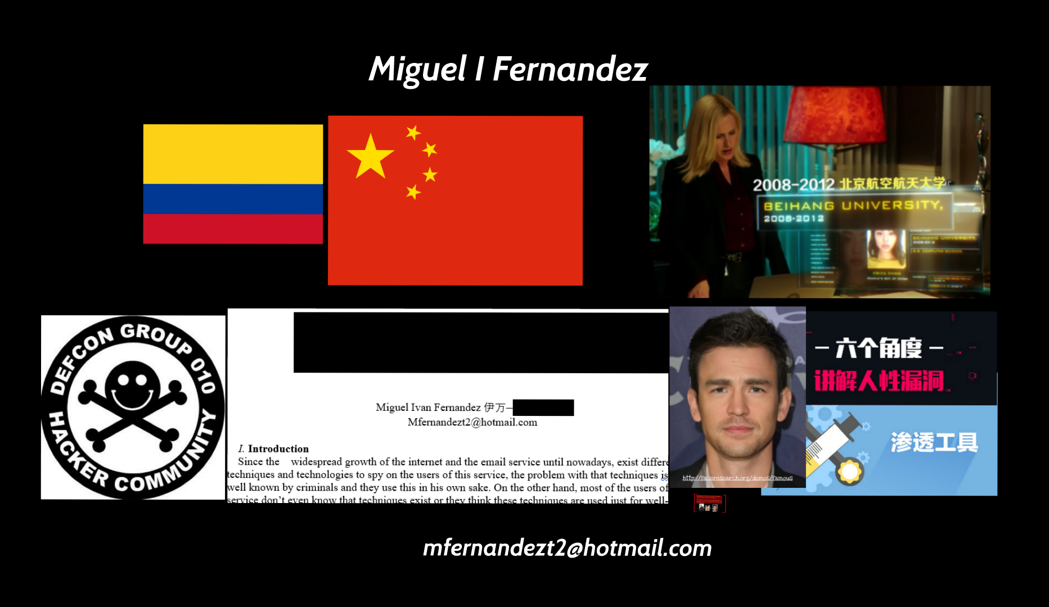
Notes:
3

Slide 4
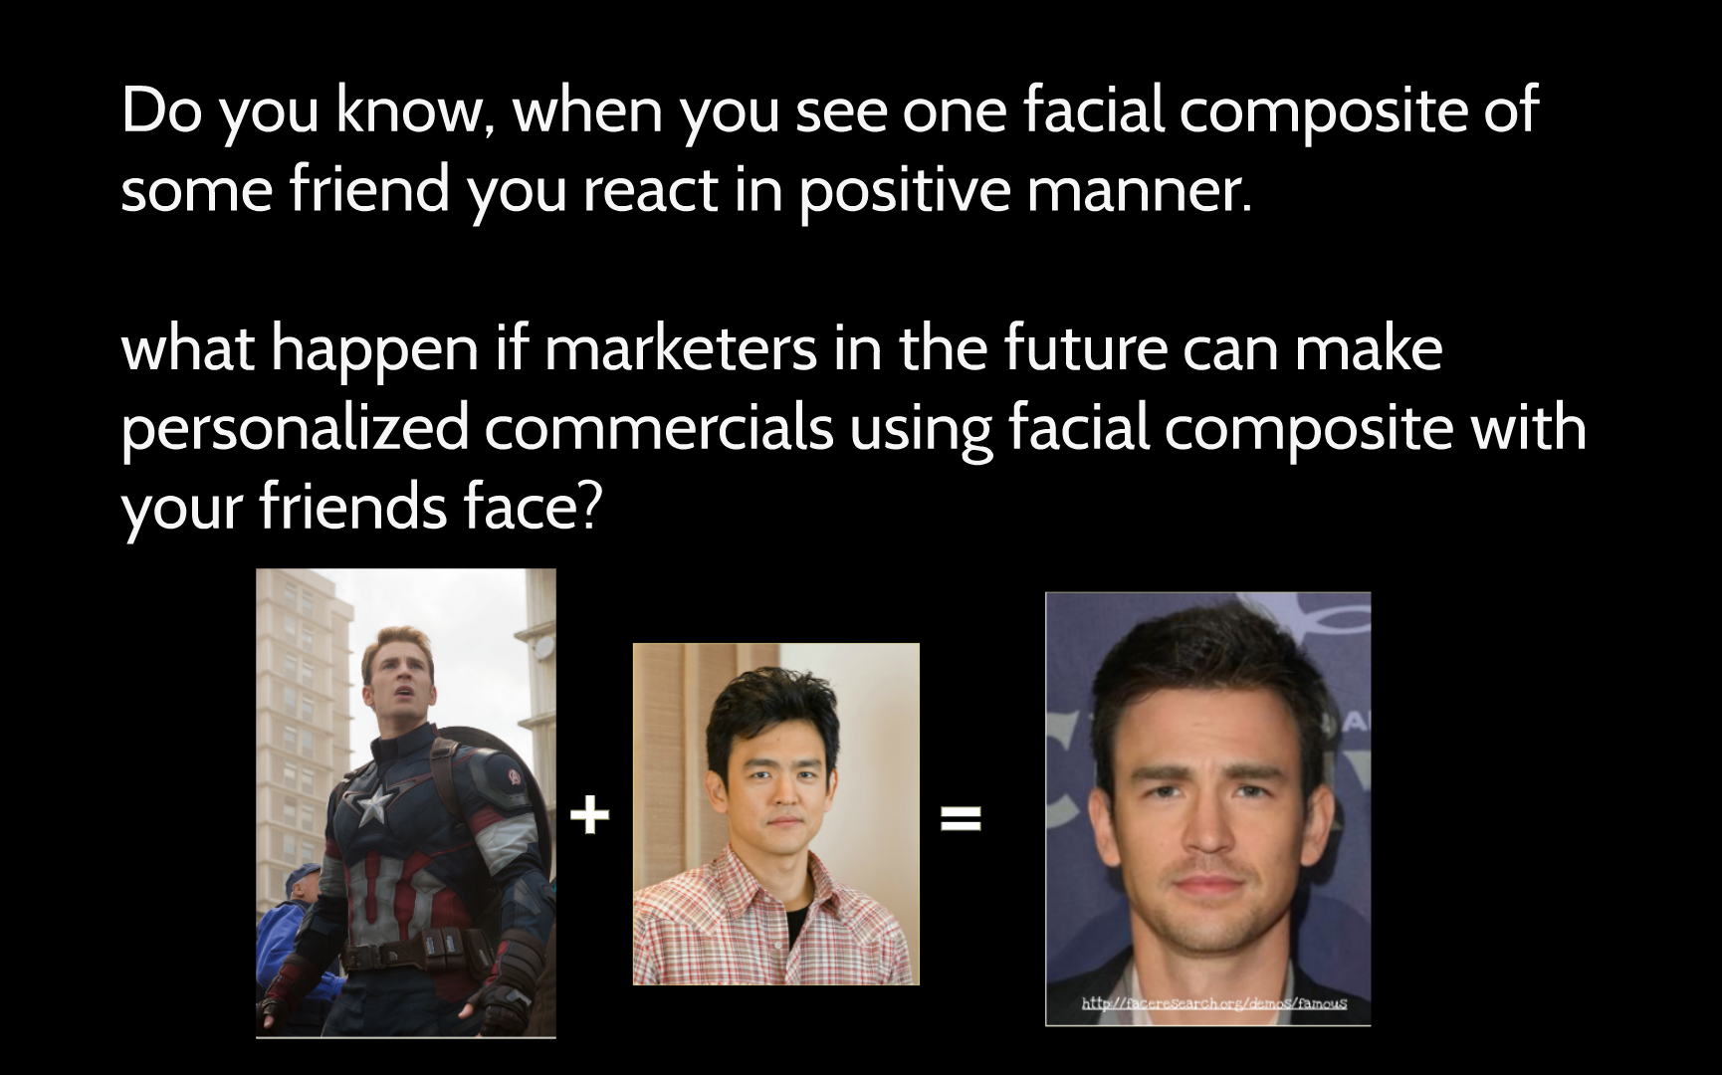
Do you know Who is he?
His name is ??

Slide 5
Do you know, when you see one facial composite of some friend you react in positive manner.
What happen if marketers in the future can make personalized commercials using facial composite with your friends face?
美国队长
John Cho
Notes:
5

Slide 6
Definitions
Hacker | Cyber criminal
Find vulnerabilities to make the systems more secure. His target is, help companies, people and others to protect his infrastructures. | Find vulnerabilities to exploit them and make money or damage. His target is make money or harm, DON’T protect anybody.

Slide 7
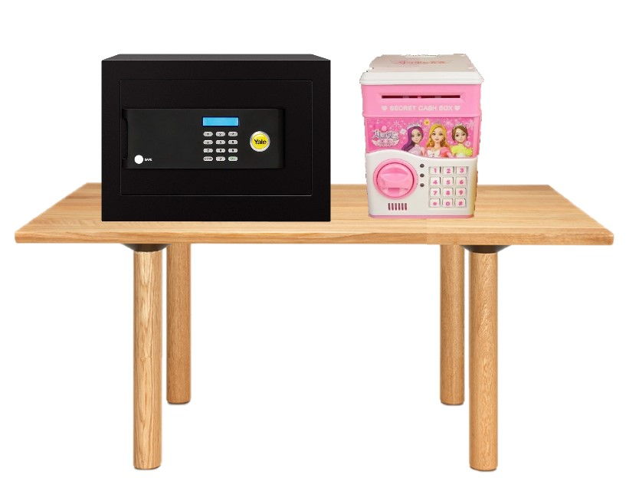
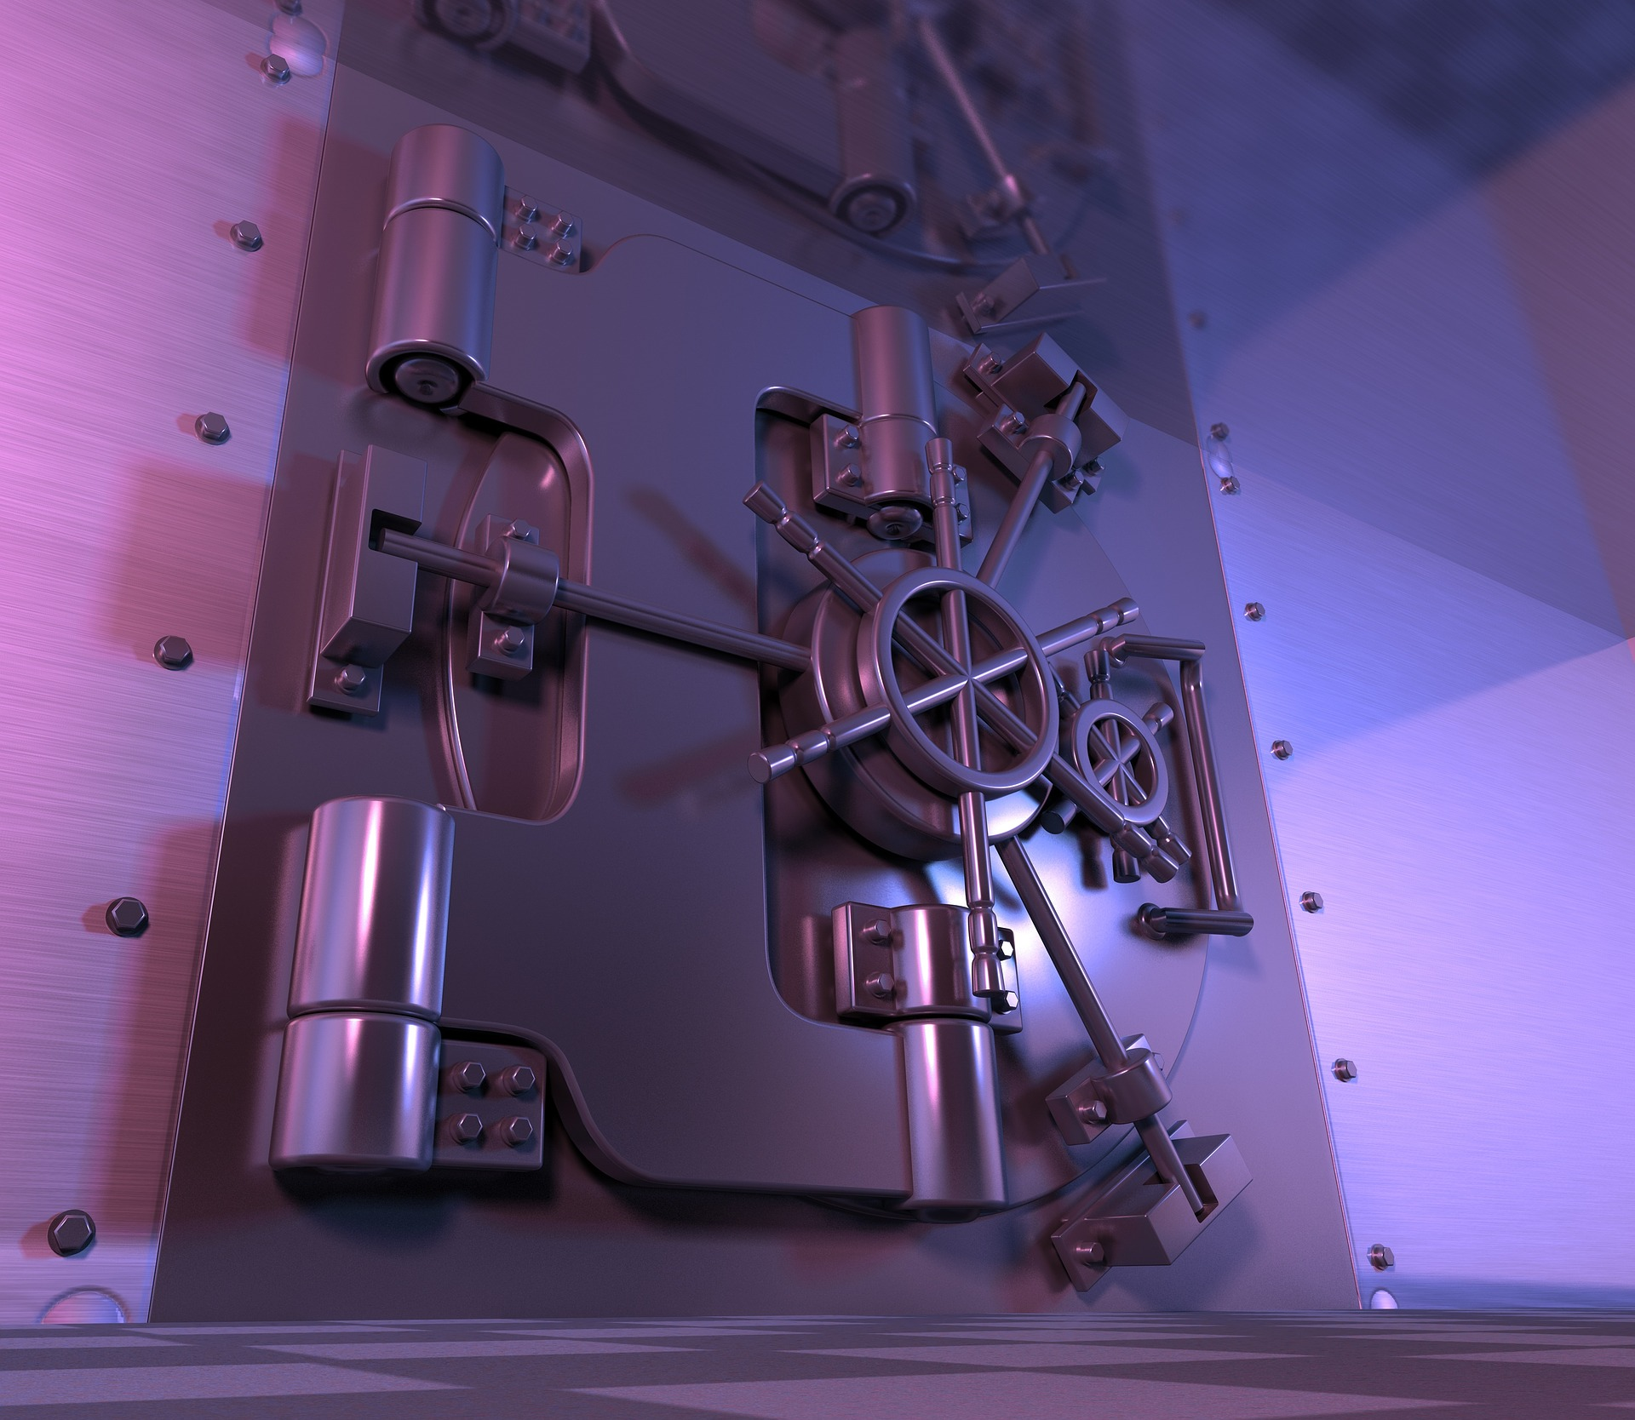
Kind of Targets
APT | Low hanging Fruit
Spear Phishing 0 day or 1day vulnerabilities Dumpster Diving Vishing Many to One | Spam or Phishing One to Many

Slide 8
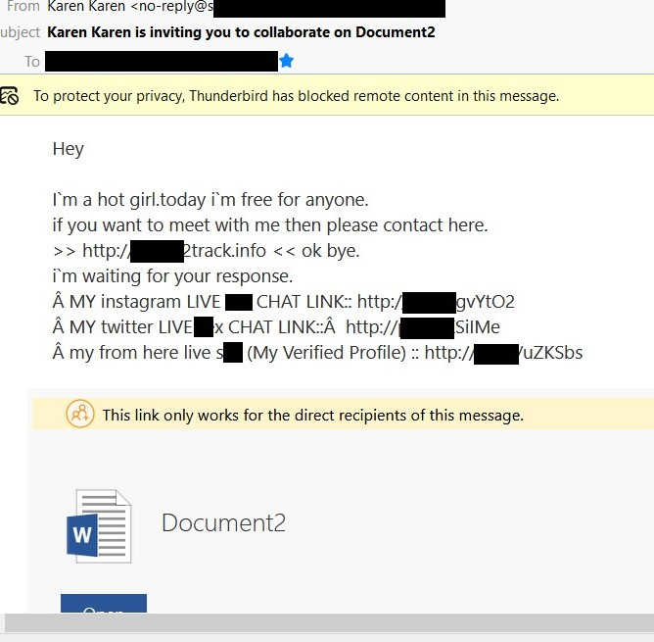
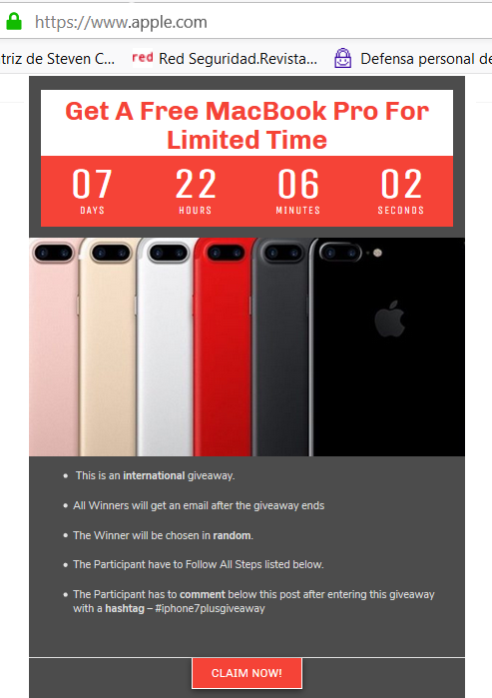
Low Hanging Fruit Example
Notes:
Is the iphone page fake or not? https
8

Slide 9
Bad Passwords 1
 | 2018 | 2017
1 | 123456 | 123456
2 | password | password
3 | 123456789 | 12345678
4 | 12345678 | qwerty
5 | 12345 | 12345
6 | 111111 | 123456789
7 | 1234567 | letmein
8 | sunshine | 1234567
9 | qwerty | football
10 | iloveyou | iloveyou
Most used passwords
Methods for passwords
Wechat_123456 (51.7)
Taobao_123456 (55.9)
126_123456 (26.2)
Qq_123456 (34.5)
Notes:
Password entropy is a measurement of how unpredictable a password is.
Bits de entropia
9

Slide 10


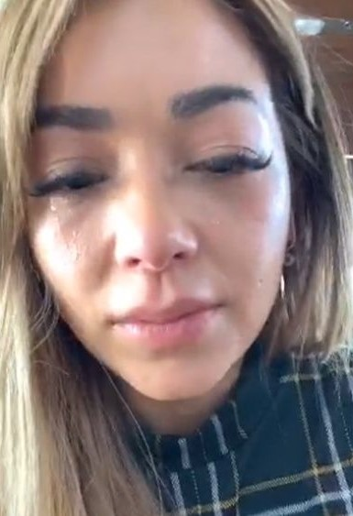

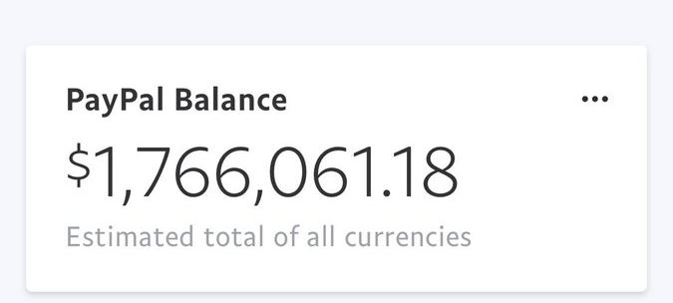
Bad Passwords 2
Re-use Passwords
Phishing
91% of the people know about this but 61% still Re-use

Slide 11
Open WIFI networks
One of the most Dangerous situations because you can be subject of:
Eavesdropping
Traffic changing
DDOS
Robbed
profiled
video

Slide 12
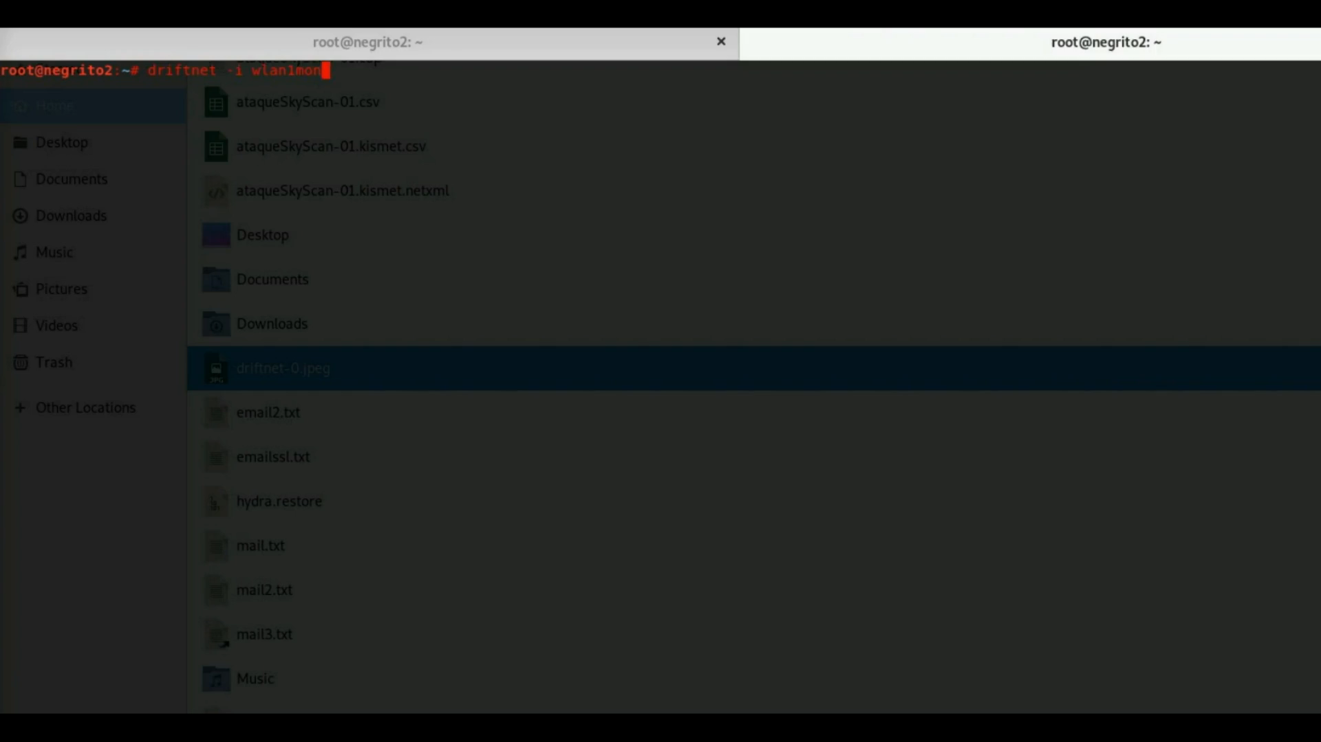
Open WIFI networks
video

Slide 13
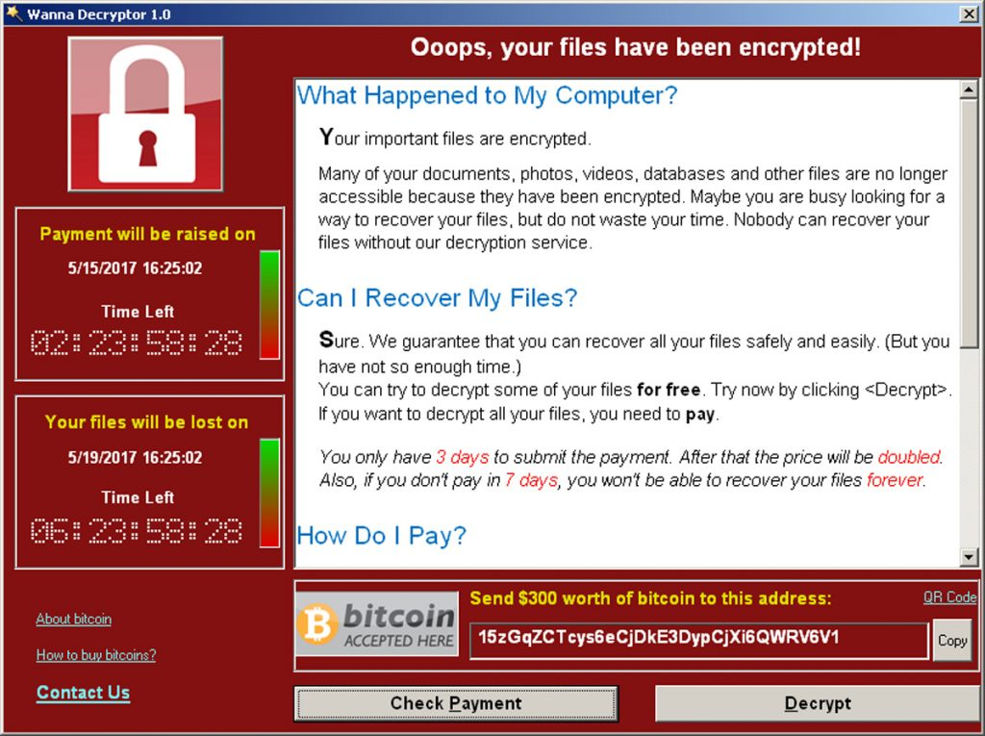
Malware
Is any software designed with the only purpose of gain unauthorized access or damage one system.
Rootkits
Worms
Keyloggers
Ransomware
Video keylogger

Slide 14
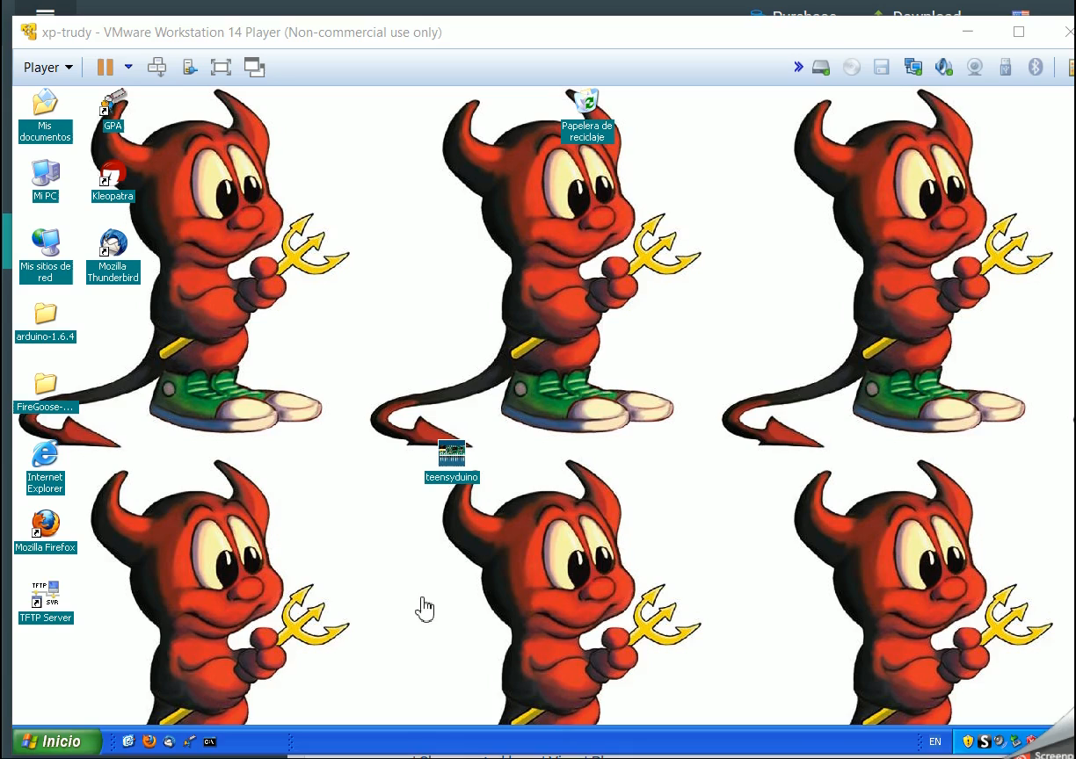
Malware
Video keylogger

Slide 15
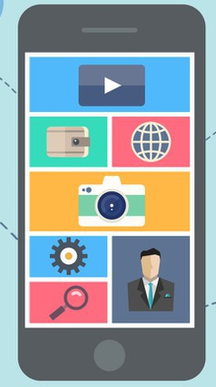
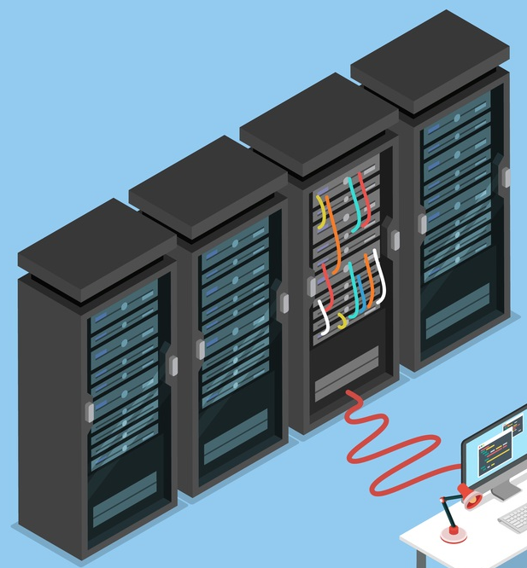

Vulnerabilities
Is a weakness which can be exploited by a threat actor, such as an attacker, to perform unauthorized actions

Slide 16
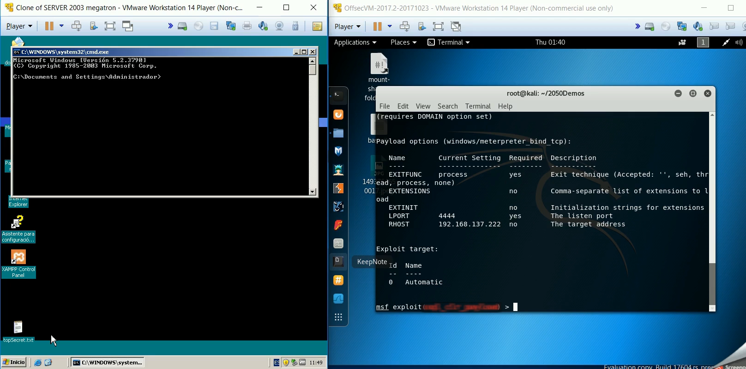
Vulnerabilities

Slide 17
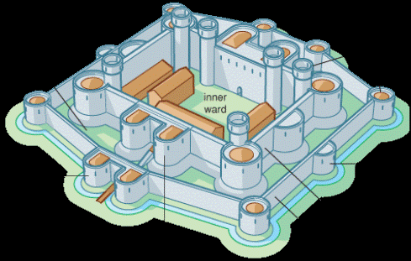
How can I protect *
Security is a process.
A chain is only as strong as its weakest link.
Security in deep
Reduce the attack surface
Update your Software
* = Computer, Network, Company, Information, me, persons

Slide 18
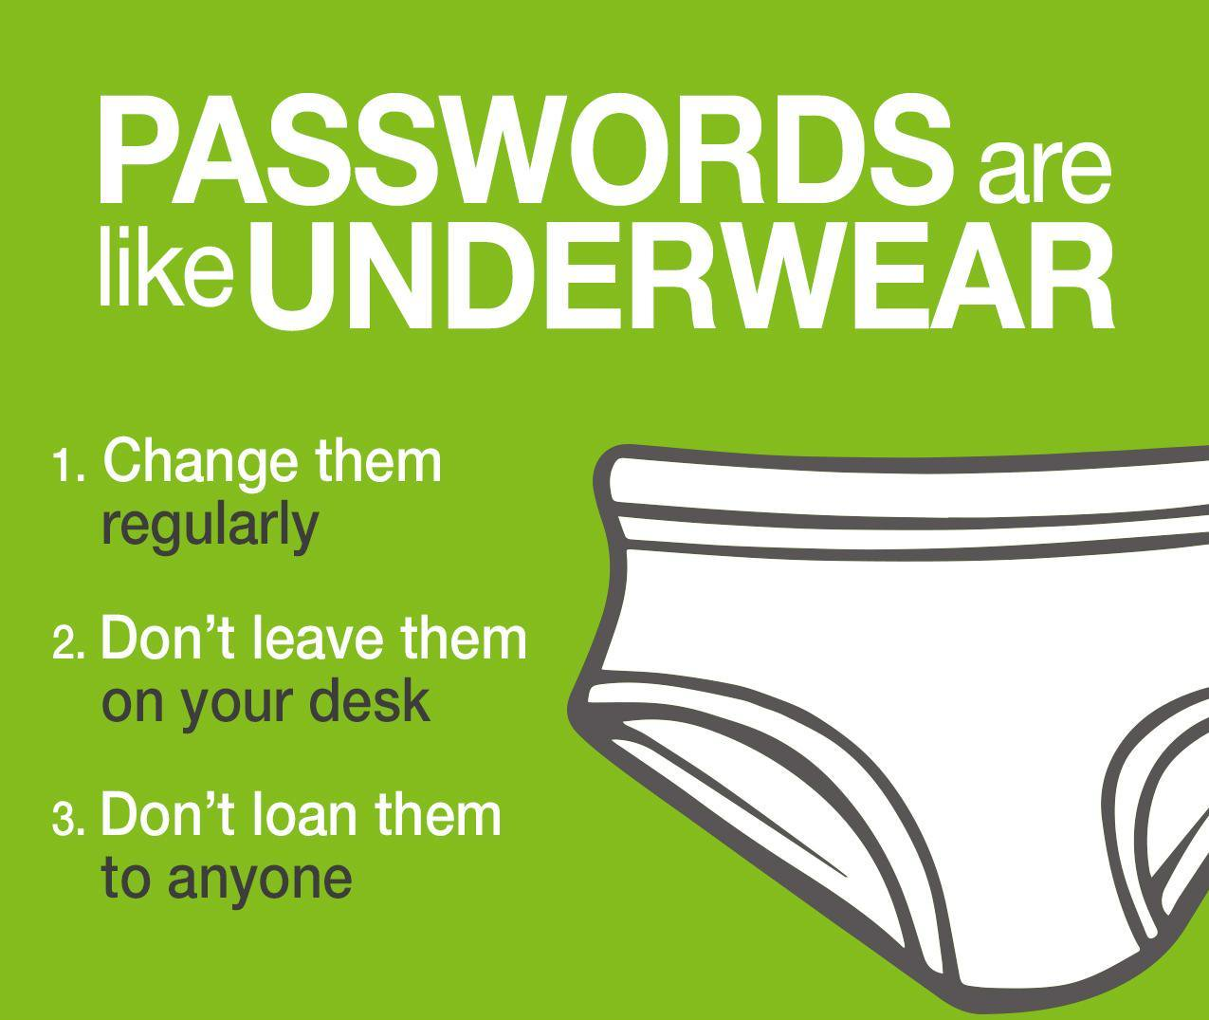
How can I protect *
Against | What to do!
vulnerabilities | Update your software, update your code and applications.
Malware | Updated Av, listen your device, stay alert.
Open Wifi | Use VPN, check the web Certificates, don’t do anything important while you are using this WIFI.
Passwords | Don't Reuse it, long is better than complex, poetry.
* = Computer, Network, Company, Information, me, persons

Slide 19


THANKS！

