Slide 1

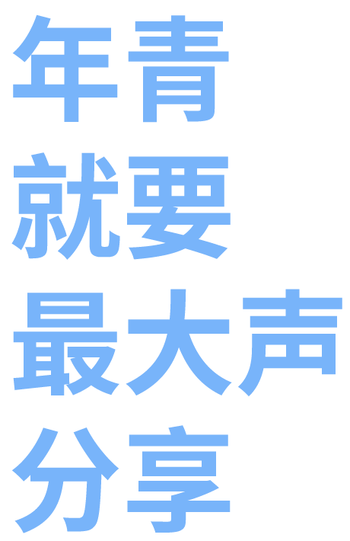





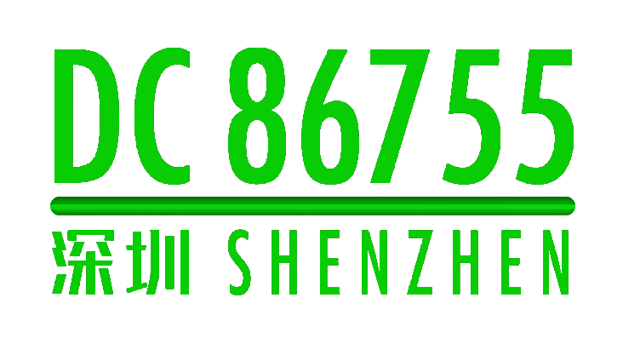




Slide 2
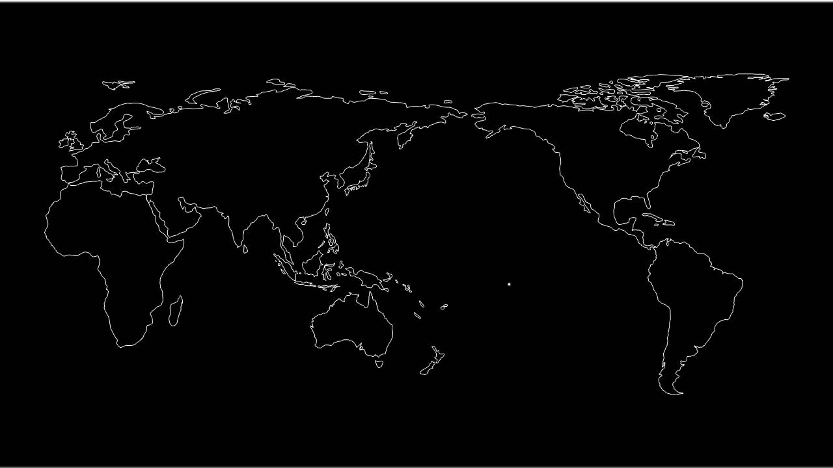


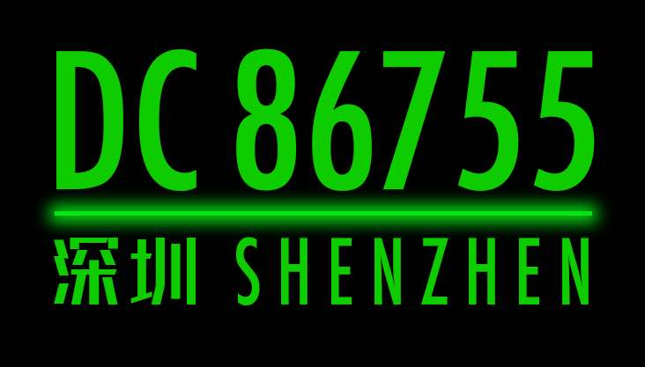
DEFCON GROUPS 中国
GLOBAL INNOVATION AND THE PERSONALITY OF NATIONS
Through destruction comes new norm
Through grouping comes amplified power
不破不立，不聚不利

Slide 3
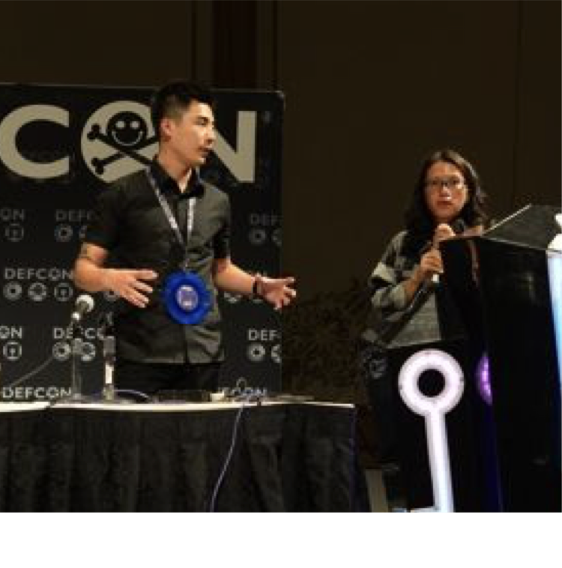
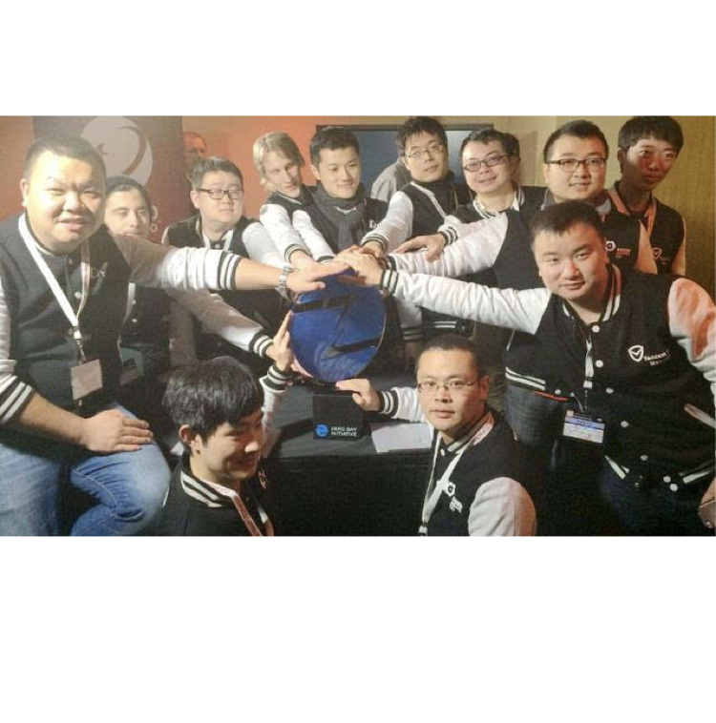
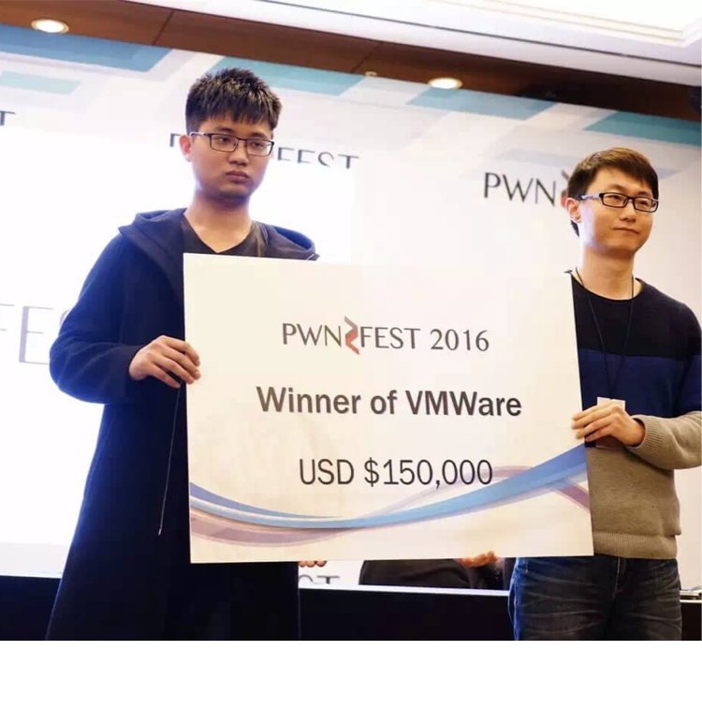
Rise of China’s White-hats
The mid 2010’s saw a tremendous surge in Chinese white hat hacking
Innovative security research community, frequently participating in international conferences
Collecting top prizes in global competitions

Slide 4
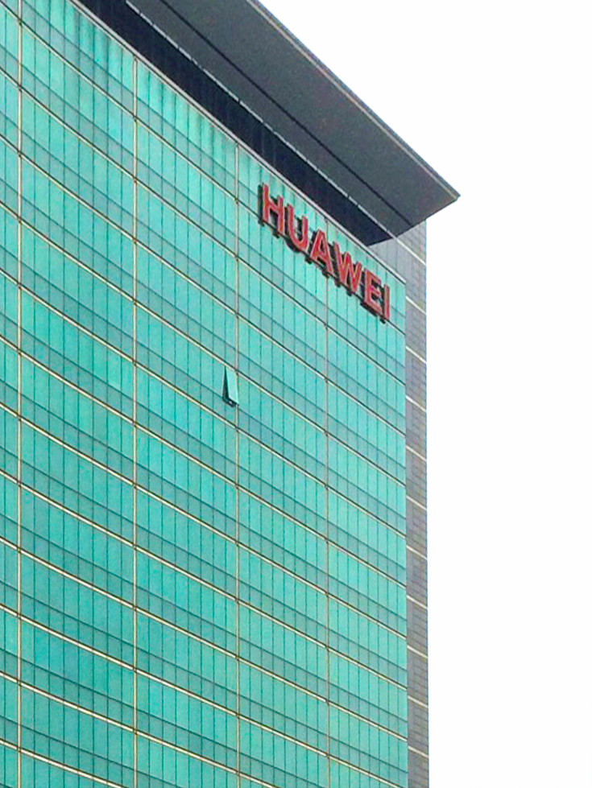
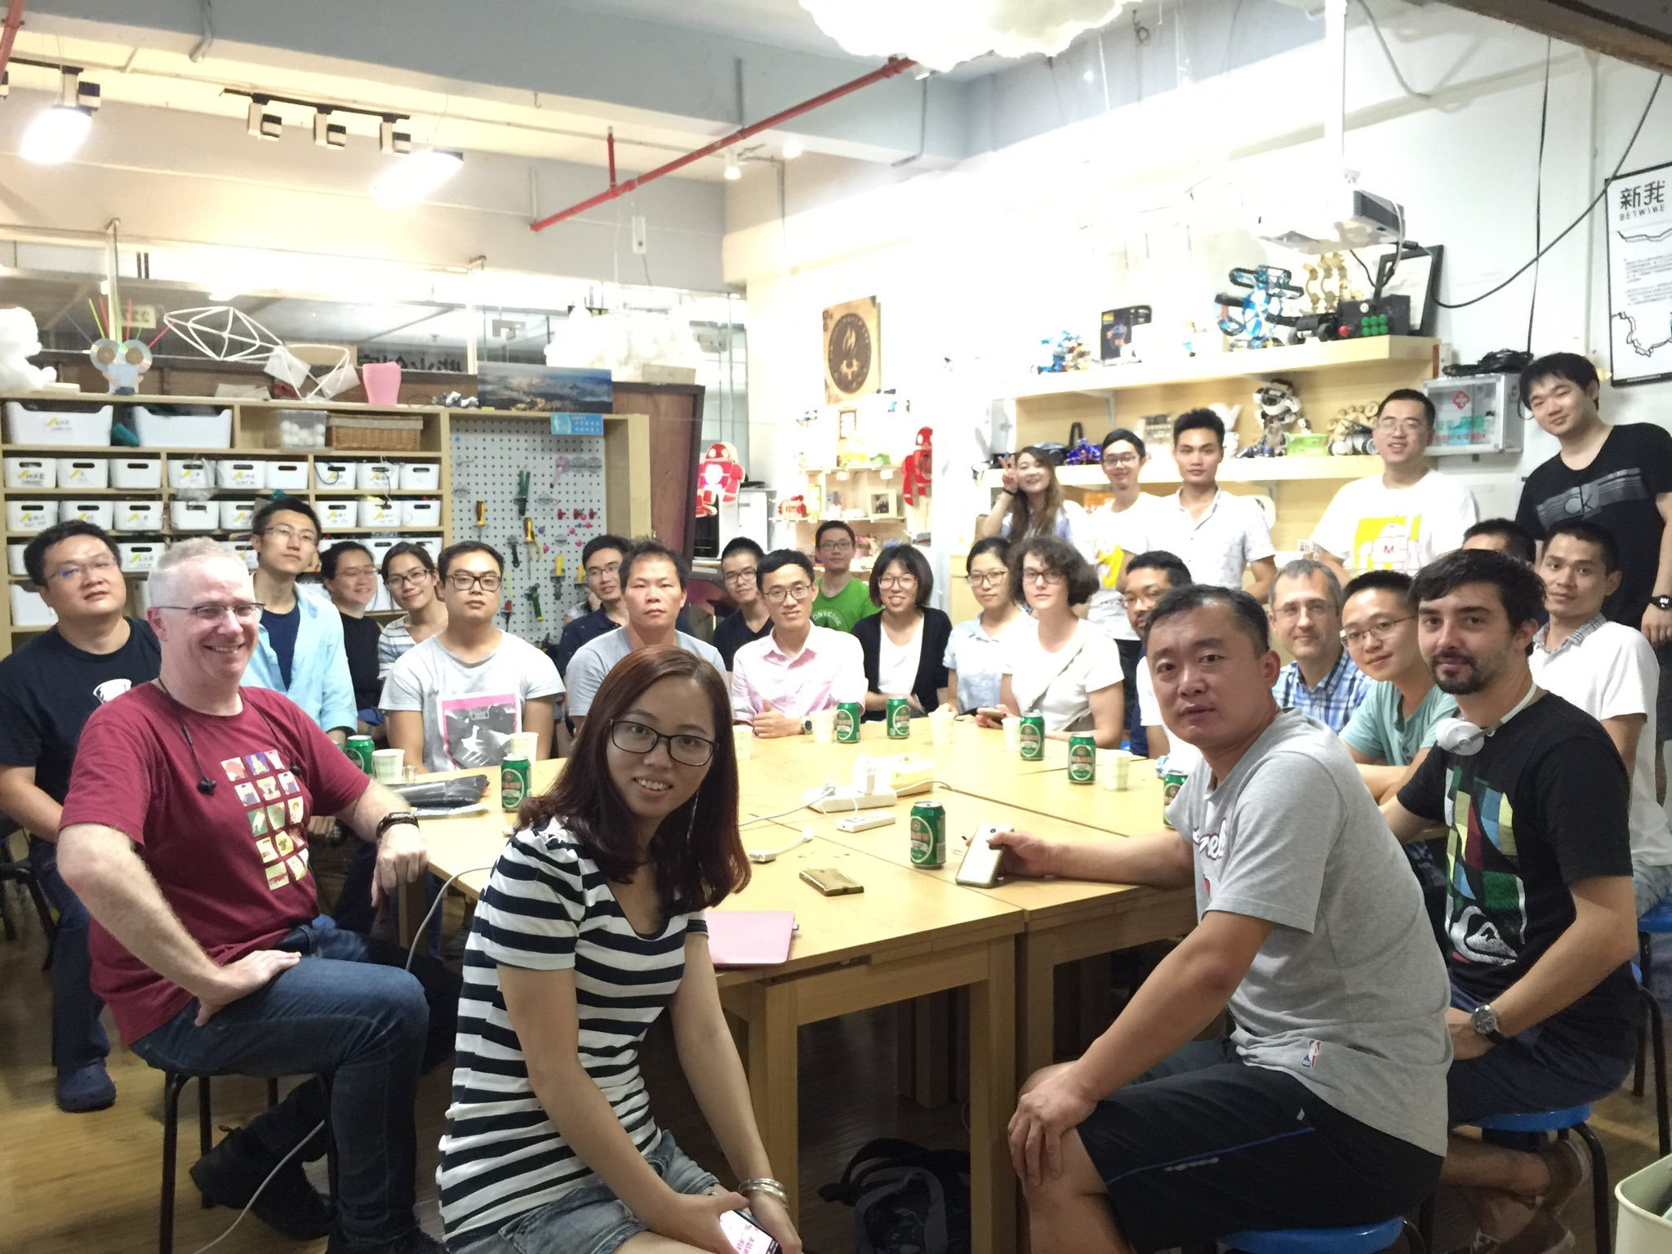
Background
Working with white-hats at Huawei,
Playing at out local Shenzhen DEFCON group,
Discovering how the hacker spirit has developed in China.

Slide 5
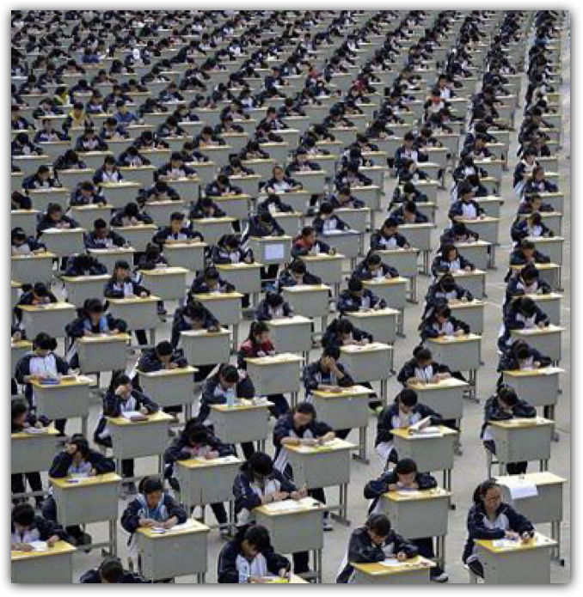
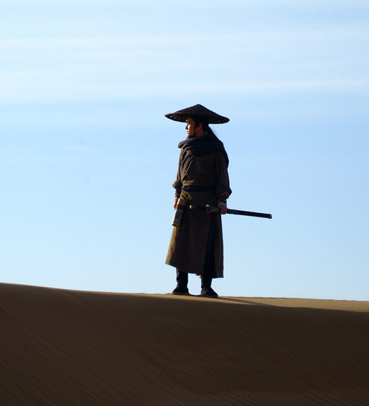
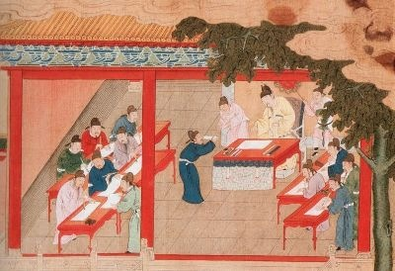
Background
From the hacker’s Xiake ancestors
Through the development of meritocracy through education
To the pressures of life in modern China.
How creativity and innovation interact with personality and culture

Slide 6
Innovation and Personality
Innovation comes from unique personality traits that rarely coexist in an individual.
Innovation requires collaborative, and depends on mutual understanding and respect between these personalities.
Organizational and national cultures promote distant personalities which can suppress innovation.
But these differences can be harnessed to enhance innovation – across organizations, and across nations.

Slide 7
Traits, Types and Personality
  Measuring traits – Big 5/FFM/OCEAN
  Organizing Traits – Myers-Briggs Type Indicator
  Different tools for different tasks
  Other caveats

Slide 8
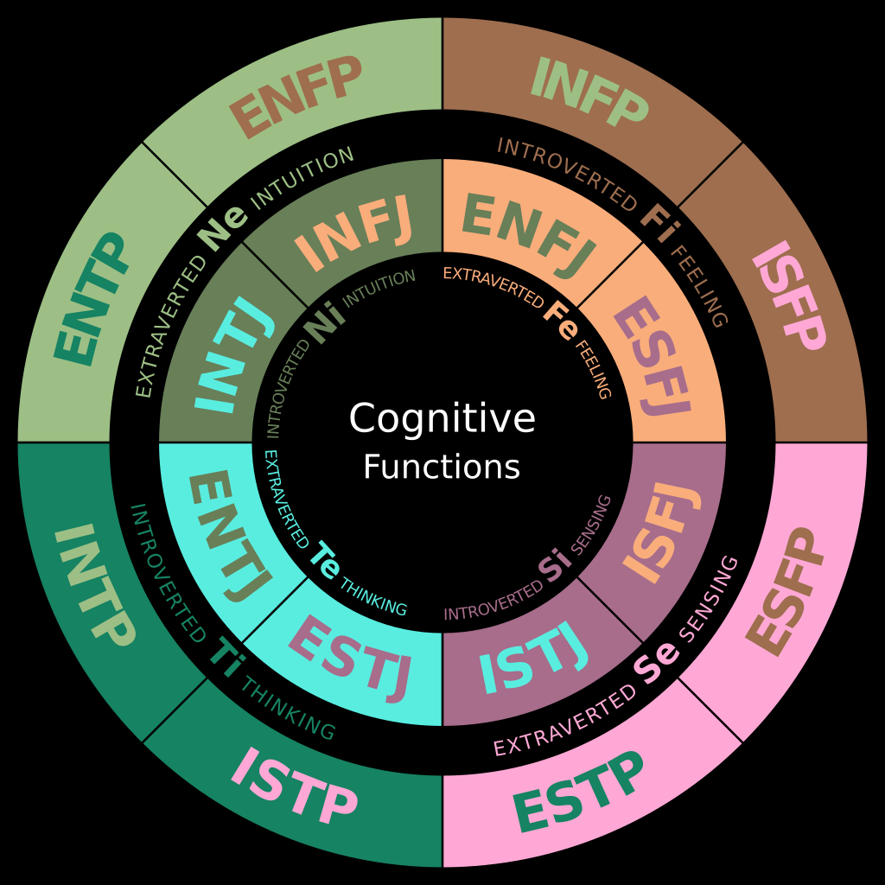
Myers-Briggs
Based on Jung’s theory of psychological types
Jung speculated that humans experience the world though four psychological functions: sensation, intuition, feeling, and thinking – and that one of these functions is generally dominant

Slide 9
Extraversion/Introversion
Attitude towards the external world
Extraverts:
Introverts:
Energized by interaction with people and objects in the outside world.
Demotivated by solitude.
Learn best by interacting with others and the physical world.
Low cortical arousal
Exhausted by interaction with the external world.
Draw energy from solitude.
Learn best exploring ideas and concepts internally.
High cortical arousal

Slide 10
Sensing/Intuition
Perceiving Functions
Sensing
Intuition
Prefer tangible, immediate information
“Just the facts, ma’am”
众盲摸象
Prefer abstract, related information
走马看花

Slide 11
Thinking/Feeling
Judging Functions
Thinking
Feeling
Look for the basic principle when deciding something.
Consistent and logical.
Value truthfulness above feeling.
Consider the feelings and points of view of those involved in a situation.
Establish and maintain harmony.
Value tact above truthfulness.

Slide 12
Judging/Perceiving
Extraversion of Function
Judging
Perceiving
Create and execute plans
Decide and move on
Sense of control from deciding early
Predictability
Wait for more information
Sense of control from keeping options open and choosing only when necessary
Adaptability

Slide 13
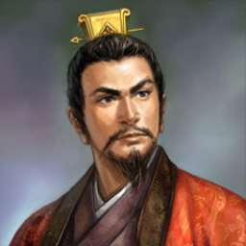
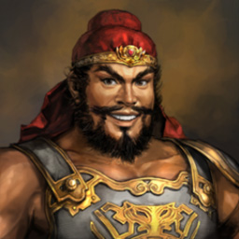
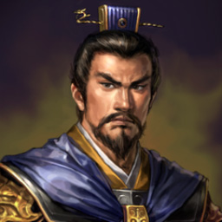
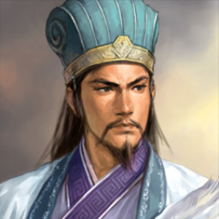
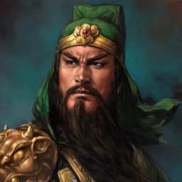
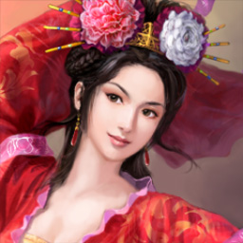
Three Kingdoms Character Types
刘备
INFP
张飞
ESFP
曹操
ENTJ
诸葛亮
INTJ
关羽
ESFJ
貂蝉
ESFP

Slide 14
Creativity and Type
Intuitive Perceiving function (*N**) has the strongest association with creativity. Adding Extraverted Perceiving (*N*P), gives resistance to quick decisions and more reflection.
But creativity strengths bring weakness in implementation.
The ability to abstract and make unexpected connections, is also susceptible to ignoring facts that do not fit the idea.
Creative types need help in observation and then execution

Slide 15
Innovation = Creativity + Delivery
Creative ideas need to be implemented to achieve innovation.
The *S*J types are best at managing and executing delivery.
N/S and P/J are dichotomies in Myers-Briggs.
Innovation requires collaboration.

Slide 16
Knowing your self and others
Framework for understanding yourself, your strengths and weaknesses. And the strengths and weaknesses of others.
Map for understanding the motivation of others
Allows you to orient yourself to the expectations of managers or other team members.

Slide 17
University of Hawaii Type Ethnicity Study
All groups
Caucasian
Japanese
Chinese

Slide 18
University of Hawaii Type Ethnicity Study
All groups
Caucasian Delta
Japanese
Delta
Chinese Delta

Slide 19
Personality and Culture
Teams, organizations, and cultures present dominant personality types.
This is can be a combination of genetic, cultural and generational influences.
Dominant types naturally shape the structure and processes in an organization.

Slide 20
Nurturing Innovation
Organizational structure and processes often prefer the dominant personality type.
When this is very dominant, it can seriously disrupt the performance of incompatible types.
Introverts and extroverts need different environments to create. Perceivers and Judgers need different management to deliver.

Slide 21
Global Innovation
“Designed in California, made in China” has been a successful approach.
Cultural dominance of specific personality types creates specialized capabilities which are very effective in a global supply chain.
Understanding and management of cultural personalities can both enhance this global cooperation, and also provide local teams with the imagination to unlock their inherent capabilities for innovation.

Slide 22
Questions…
nullzebra@gmail.com
@nullzebra

Slide 23


THANKS！

